Slide 1
Algorithms Design Approach/Patterns
DIVIDE AND CONQUER
Greedy Algorithms
Dynamic programing
BackTracking
Branch and Bound
By
Name:Ashwin Shiv
Roll No:181210013
CSE 2nd Year
NIT Delhi

Slide 2
DIVIDE AND CONQUER

Slide 3
DIVIDE AND CONQUER -3 Part TOP DOWN APPROCH
TOP down Approach to design Algorithms
Divide : Divide the problem into sub problem that is similar to original problem
Conquer Solve the problem recursively
Combine : Combine the solution of sub problem to create the solution of original problem

Slide 4
APPLICATION OF D&C ALOGORATHIM
Binary Search
Finding Max and Min
Merge Sort
Quick Sort
Strassen Matrix Multiplication
Convex hull

Slide 5
DIVIDE and CONQUER – APPROCH
ALGO DANDC (P)
{
if small (p) then return S(p)
else
{
divide P in smaller p1, p2...pk where k >=1
apply DANDC to each sub problem Recursively
return combine ( DANDC(p1), DANDC(p1) ……………… DANDC(pk))
}
}

Slide 6
Greedy Algorithms

Slide 7
Greedy Algorithms
A greedy algorithm is an algorithm that constructs an object X one step at a time, at each step choosing the locally best option.
In some cases, greedy algorithms construct the globally best object by repeatedly choosing the locally best option.

Slide 8
Greedy Algorithms – Advantages
Greedy algorithms have several advantages over other algorithmic approaches:
● Simplicity: Greedy algorithms are often easier to describe and code up than other algorithms.
● Efficiency: Greedy algorithms can often be implemented more efficiently than other algorithms.

Slide 9
Greedy Algorithms – DIS Advantages
Greedy algorithms have several drawbacks:
● Hard to design: Once you have found the right greedy approach, designing greedy algorithms can be easy. However, finding the right approach can be hard.
● Hard to verify: Showing a greedy algorithm is correct often requires a nuanced argument.

Slide 10
Greedy Algorithms – APPROCH
ALGO GREDDY ( a, n)
{
solution = 0;
for i to n do
{
x = select (a) ;
if feasible (solution , x ) ;
then solution Union (solution , x) ;
}
return solution;
}

Slide 11
Applications OF Greedy Algorithms
Activity Selection
Huffman coding
Job Sequencing
Knap Snap
Minimum Spanning tree
Single Source shortest Path
Bellman ford Algorithm
Dijkstra’s Algorithm

Slide 12
Dynamic Programming

Slide 13
Dynamic Programming
Used to solve optimization problems.
Breaks down the complex problems into simpler subproblems.
Find optimal solution to these subproblems.
Store the results of these subproblems so that it can be reused later.
Finally Calculates the result of complex sub-problem.

Slide 14
Dynamic Programming– Advantages
Time Complexity will be always less because it reduces the line code
It speeds up the processing as we use previously calculated intermediate values.

Slide 15
Dynamic Programming– Disadvantages
Space Complexity would be more as dividing problem in sub problem and storing intermediate results in consuming memory.

Slide 16
APPLICATION OF Dynamic Programming
Cutting a rod into pieces to Maximize Profit
Matrix Chain Multiplication
Longest Common Subsequence
Optimal Binary Search Tree
Travelling Salesman Problem
0/1 Knapsack Problem

Slide 17
BackTracking

Slide 18
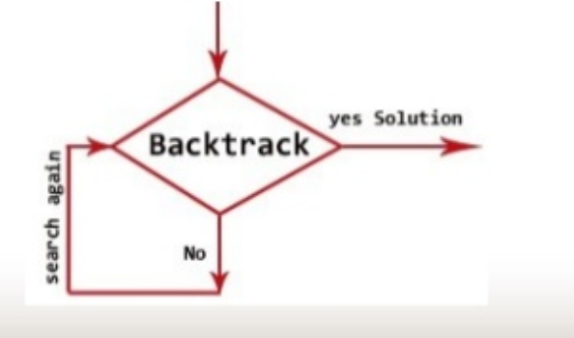
BackTracking
Backtracing uses bruit force approach to solve the problem.
The Algorithmic Approach – Backtracking systematically try and search possibilities to find the solution.
Brute force approach say for any given problem generate all possible solution and pick a desire solution.
Generate depth first search to generate state space tree.

Slide 19
BackTracking– Advantages
Comparison with the Dynamic Programming, Backtracking Approach is more effective in some cases.
Backtracking Algorithm is the best option for solving tactical problem.
Also Backtracking is effective for constraint satisfaction problem.
In greedy Algorithm, getting the Global Optimal Solution is a long procedure and depends on user statements but in Backtracking It Can Easily getable.
Backtracking technique is simple to implement and easy to code.
Different states are stored into stack so that the data or Info can be usable anytime.
The accuracy is granted.

Slide 20
BackTracking– DisAdvantages
– Backtracking Approach is not efficient for solving strategic Problem.
– The overall runtime of Backtracking Algorithm is normally slow
– To solve Large Problem Sometime it needs to take the help of other techniques like Branch and bound.
– Need Large amount of memory space for storing different state function in the stack for big problem.
– Thrashing is one of the main problem of Backtracking. – The Basic Approach Detects the conflicts too late.

Slide 21
BackTracking– APPROCH
Backtrack (v1,Vi)
{
If (V1,……., Vi) is a Solution Then
Return (V1,…, Vi)
For each v DO
If (V1,…….,Vi) is acceptable vector THEN
Solution = try (V1,…,Vi, V);
If Solution != () Then
RETURN Solution ;
}
}
}

Slide 22
APPLICATION OF BackTracking
N Queen Problem
Sum of subset problem
Graph Coloring problem
Hamiltonian Circuit Problem
Maze Problem

Slide 23
Branch and Bound

Slide 24
Branch and Bound
Branch and bound is an algorithm design paradigm which is generally used for solving combinatorial optimization problems.
These problems are typically exponential in terms of time complexity and may require exploring all possible permutations in worst case.
The Branch and Bound Algorithm technique solves these problems relatively quickly.
BFS (Brute-Force)We can perform a Breadth-first search on the state space tree. This always finds a goal state nearest to the root. But no matter what the initial state is, the algorithm attempts the same sequence of moves like Depth-first-search DFS.
Branch and Bound. The search for an answer node can often be speeded by using an “intelligent” ranking function, also called an approximate cost function to avoid searching in sub-trees that do not contain an answer node. It is similar to the backtracking technique but uses BFS-like search

Slide 25
Branch and Bound– APPROCH
FIFO Branch Bound ( First IN First OUT)
LIFO Branch Bound ( Last IN First OUT)
LC Branch Bound ( Least Cost )

Slide 26
APPLICATION OF Branch and Bound
0/1 Knapsack Problem using Least Cost Branch and Bound Algorithm
Travelling Salesman Problem using Branch and Bound

Slide 27
0/1 Knapsack Problem using Dynamic Programming
In these kinds of problems,we are given some items with weights and profits.
The 0/1 denotes that either you will not pick the item(0) or you can pick the item completely(1).
Cannot take a fractional amount of an item taken or take an item more than once.
It cannot be solved by the Greedy Approach because it is enable to fill the knapsack to capacity.
In simple words,0/1 Knapsack Problem means that we want to pack n items in a bag(knapsack):
The ith item is worth pi(profit) and weight wi kg.
Take as valuable a load as possible, but cannot exceed W pounds.
pi,wi,W are integers.

Slide 28
Why Dynamic Programming to solve 0/1 Knapsack Problem?
It is a very helpful problem in combinatorics.
Recomputation is avoided as it stores the result of previous subproblem so that it can be used again in solving another subproblem.

Slide 29
Algorithm
Knapsack(n,cw)
int M[][] = new int[n + 1][cw + 1];//Build a memoization matrix in bottom up manner.
for i<-0 to n
for w<-0 to cw
if (i == 0 || w == 0) then
M[i][w] = 0;
else if(gwt[i - 1]<= w) then
M[i][w] = max(pro[i - 1] + M[i - 1][w - gwt[i - 1]], M[i - 1][w])
else
M[i][w] = M[i - 1][w]
return M[n][cw]

Slide 30
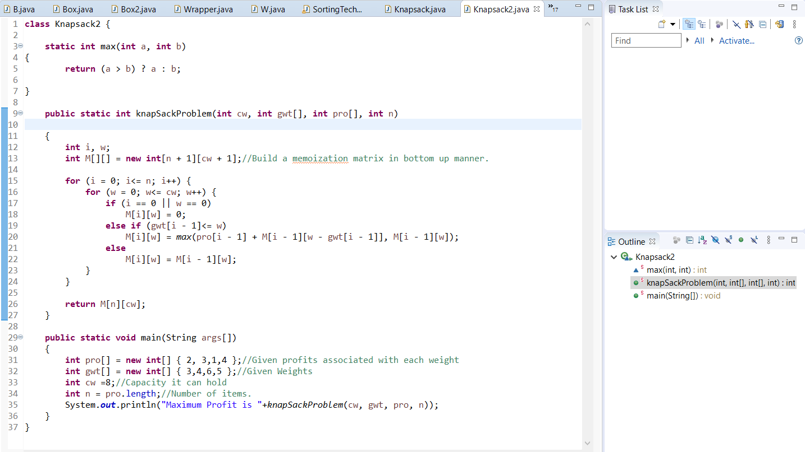

Code in Java to solve 0-1 Knapsack problem Solution using Dynamic Programming to get Maximum Profit
My Java Program

